Slide 1
BREAST CANCER CLASSIFICATION

Slide 2
INTRODUCTION
Early detection of cancers are essential for a rapid response and better chances of cure. Unfortunately, early detection of cancers are often difficult because the symptoms of the disease at the beginning are absent.
Breast cancer is a cancer that develops from breast tissue.It is a malignant disease caused by an uncontrolled growth of cells in the breast.
Breast cancer classification divides breast cancer into categories according to different schemes criteria and serving a different purpose. The major categories are the histopathological type, the grade of the tumor, the stage of the tumor, and the expression of proteins and genes.

Slide 3
Symptoms of breast cancer:
A lump or mass in the breast.
Swelling of all or part of the breast.
Skin irritation or dimpling.
The nipple or breast skin appears red, scaly, or thickened.
Nipple discharge.

Slide 4
How to reduce risk of breast cancer?
Limit alcohol- The more alcohol you drink, the greater your risk of developing breast cancer.
Don’t smoke- Evidence suggests a link between smoking and breast cancer risk, particularly in premenopausal women.
Control your weight- Being overweight or obese increases the risk of breast cancer.
Be physically active- Physical activity can help you maintain a healthy weight, which helps prevent breast cancer.
Avoid exposure to radiation and environmental pollution.

Slide 5
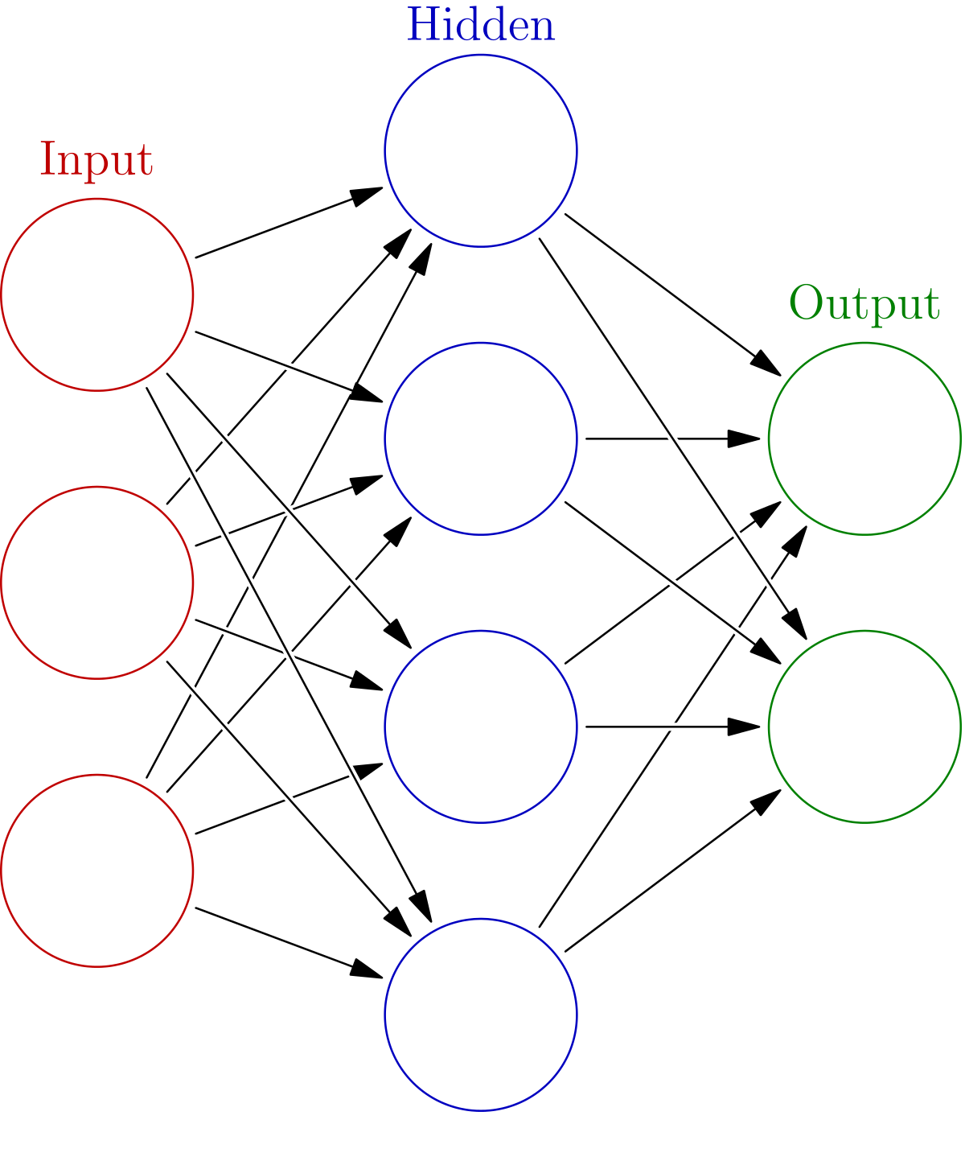
METHODOLOGY
An ANN is based on a collection of connected units or nodes called artificial neurons , which loosely model the neurons in a biological brain.
Each connection, like the synapses in a biological brain, can transmit a signal from one artificial neuron to another.

Slide 6
FUTURE SCOPE
For medical checking and reports will take a lots of time of patients as well doctor’s time too. So, it is time consuming process proceeding by pathology specified doctor and assistants, In thesis report this time spending process is done by just few mints and report will generate in short period of time then patients treatment will do further and faster.
This software will use in pathology laboratories in short time will detect cancer in which stage after this doctor will suggest for further treatments.

Slide 7
CONCLUSION
An implementation of our new system to expose the cancer risk factors and to ensure that people are provided with the information and support they need to adopt in a healthy lifestyles.

Slide 8
THANK YOU
Y.Abhinaya
L.Bhumika
K.Mamatha
N.Shruthi
G.Sreeja
Vaishnavi

